Slide 1
Cyclistic Bike Usage Analysis: Annual Members vs. Casual Riders
Data-Driven Insights to Enhance Member Retention and Conversion
Marycruz Vera Bedolla
6/18/2024

Slide 2

Introduction
Brief overview of Cyclistic and the goal of the analysis.
Business question: "How do annual members and casual riders use Cyclistic bikes differently?"
Importance of the study for strategic decision-making.

Slide 3
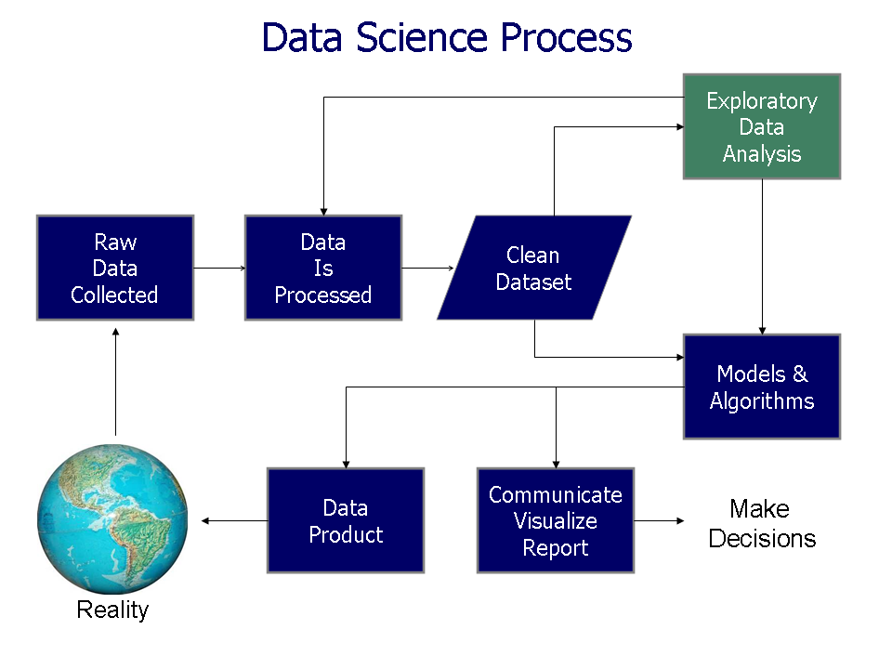
Data Preparation
Data sources: Cyclistic ride data (2019-2020).
Data storage and organization: Stored on Office 365, organized by year and month.
Data cleaning process: Addressed duplicates, negative values, and ensured uniform column names.

Slide 4

Data Processing
Tools used: Excel and R for data manipulation and analysis.
Key data transformations: Added ride_length and day_of_week columns, handled missing values.
Ensured data integrity: Verified and documented the cleaning process.

Slide 5
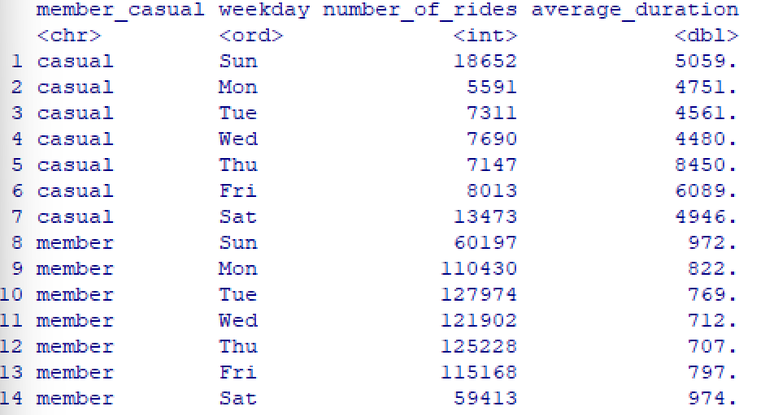
Analysis Overview
Aggregated data for ease of analysis.
Calculated key metrics: mean, median, min, max ride lengths.
Comparison between casual riders and annual members based on ride frequency and duration.

Slide 6
Usage Patterns
&
Insights
Casual riders have a higher average ride duration compared to annual members.
Subscribed members consistently produce the highest number of rides throughout the week.
Peak usage days: Casual riders peak on Thursdays, annual members peak on weekends.
Casual riders ride longer but less frequently.

Slide 7
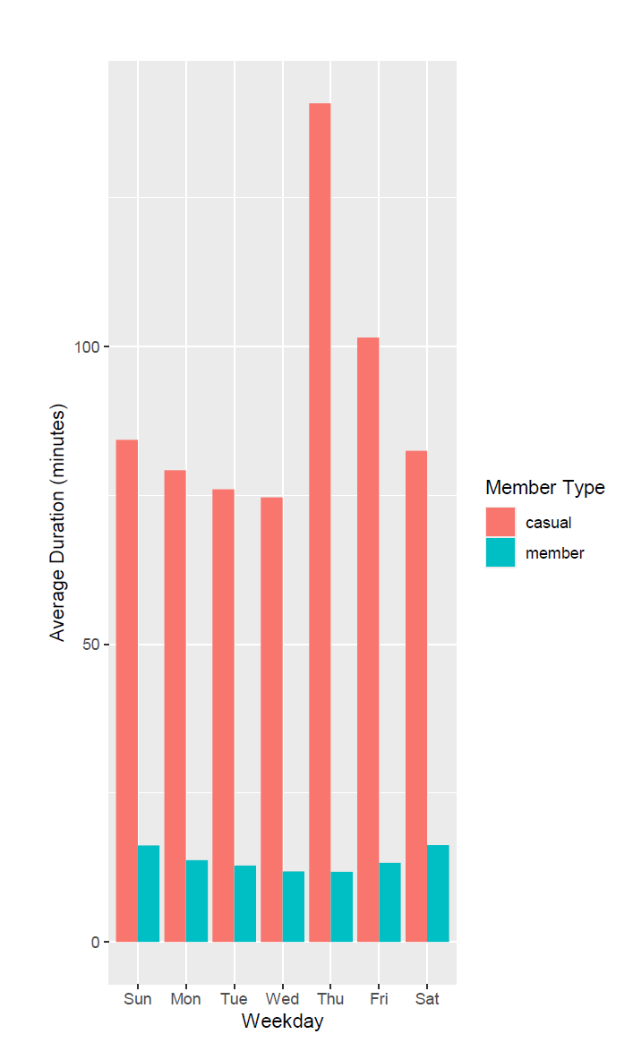
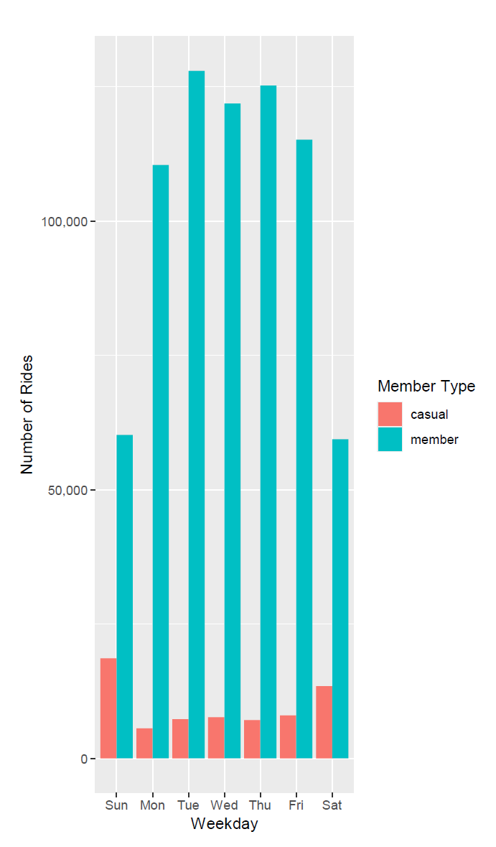

Slide 8

Recommendations
Implement a rewards program for casual riders to convert them into annual members.
Promote weekend biking events or incentives for annual members.
Consider targeted marketing campaigns based on peak usage times.

Slide 9

Conclusion
Summary of findings: Different usage patterns between casual and annual members.
How these insights address the business question and can drive strategic decisions.
Next steps: Implementing recommendations and potential further data analysis.

Slide 10

Q & A
Open floor for questions from the executive team.

